Slide 1
Statistics In FRC
Caleb Sykes
Presented at FIRST Bootcamp, December 2019

Slide 2
Who am I?
Caleb Sykes
Student, FRC 2052 (2009-2013)
Mentor, FRC 4536 (2013-2017)
Has played around a lot with FRC statistics (2016ish to present)
B.S. in Electrical Engineering from the University of Minnesota
M.S. in Electrical Engineering from the University of Minnesota
Electrical Engineer at MWResource, Inc (2019 to present)

Slide 3
Definitions
OPR: Offensive Power Rating, I use it interchangeably with calculated contribution because I hate the name OPR
Half-match: All of the match data for one alliance in one match
Elo: When I talk about Elo, I’m referring specifically to the Elo model I have developed and published. Calculated contributions have been around long enough to have become standardized, but since Elo is still very new to FRC, there exist alternate models.

Slide 4
How do we calculate these metrics?
We’re not going to be able to get to that here, but I have slides at the end of the presentation outlining how to calculate them in addition to links to other sources
Calculated contributions are kind of like averages, but better since they incorporate how good your partners are.
Elo is an iterative strength estimator where you gain or lose points each match depending on if your alliance overperformed or underperformed expectations.

Slide 5
Why use metrics at all, shouldn’t we just scout?
Obviously, yes you should still be scouting
The insights that you can get from non-scouting metrics are nowhere near developed enough to completely supplant traditional scouting metrics. That said, there are shortcomings in traditional scouting that can be supplemented with algorithmic metrics.
As an example, how do you prepare for a match when you are early in the event and haven’t seen teams play yet? Particularly if it’s the first event of the season or if no match video exists of a team’s prior event?
The key here isn’t to waste time trying to figure out which methodology is strictly better than the other, but to look at the strengths and shortcomings of both and to choose the right tool for the task at hand.

Slide 6
Elo, OPR, CCWM, DPR, WMPR
Elo and OPR have the most predictive power of any general “team strength” metric. The other metrics are not worth using for this purpose in my opinion. The average of the Elo and OPR Win Probability predictions are better than either separately (looking to combine them soon).
DPR is pretty close to noise. So close in fact that it’s not even intuitive to me if higher or lower DPRs are better, and it may even depend on the year.
Because of relationship CCWM = OPR – DPR, if we rewrite DPR as “noise”, we get CCWM = OPR + noise. So in my opinion, CCWM is essentially just an inferior version of OPR because of the extra noise.
WMPR (Winning Margin Power Ranking) has even less predictive power than CCWM. If you haven’t heard of this metric, don’t worry, I don’t think you are missing much.

Slide 7
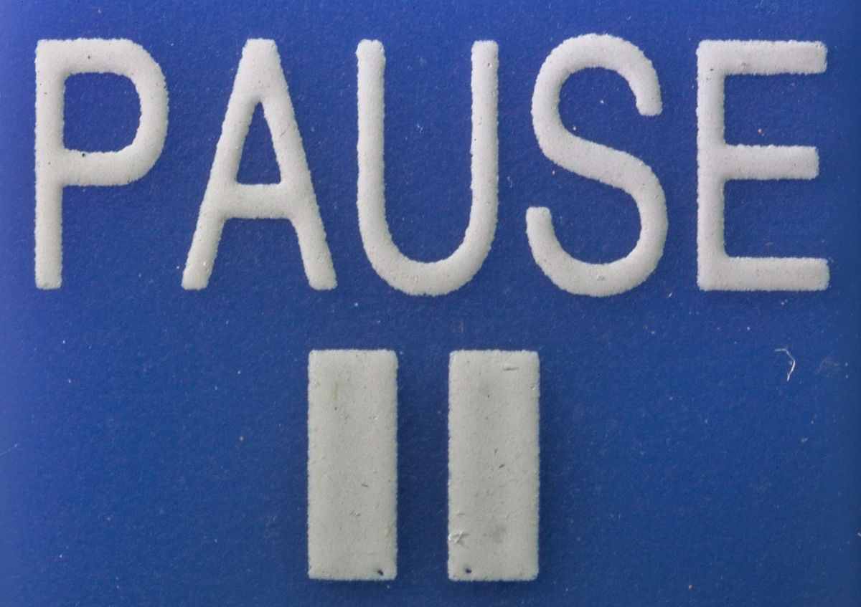
Pause for questions

Slide 8
Match strategy
The thing people tend to focus on the most in match strategy is how to get your alliance to score the most average points. And with good reason! My advice broadly for this is:
Try not to get in each others way, especially if there is defense
Get everyone to spend as much time as possible doing what they are best at. Think about opportunity costs, even if a team is better than you at everything, that does not mean they should be doing everything.
Look at resource management (loading stations, game pieces, starting locations, ending locations) and determine how to allocate these best among teams
However, there’s another aspect of match strategy that I also believe to be important that frequently gets overlooked, which I’m going to call “variance adjustment”. If I can get you to take one thing away from this presentation, it is that you should be thinking about variance in addition to averages when you are choosing strategies.

Slide 9
Variance adjustment
If you are the favorite in a match, you want low variance. There are less ways for the opponent to win if everything is under your control.
If you are the underdog in a match, you want high variance. There are more opportunities for upsets when things are “out of control” because although you can’t necessarily control them, your opponent can’t either.
If you are roughly equal with the opposing alliance, the variance doesn’t matter much. So you should just be focusing on getting a high average score.

Slide 10
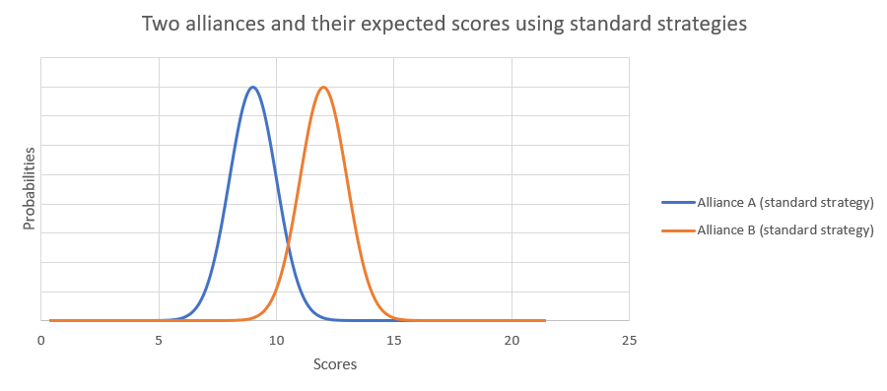
Variance adjustment
Alliance B (orange) is a clear favorite here

Slide 11
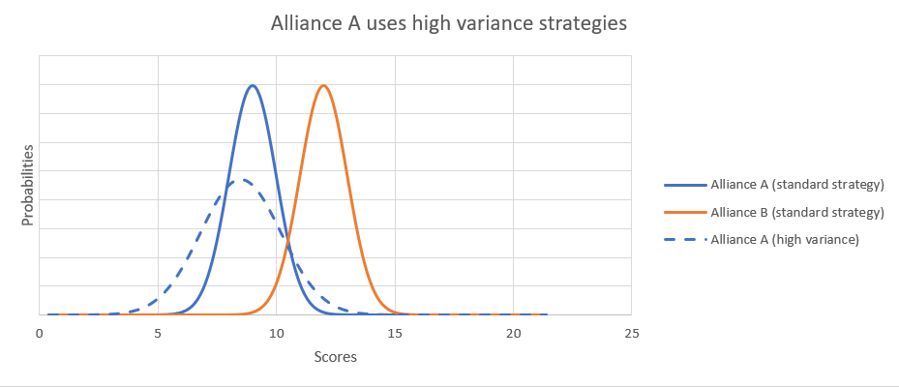
Variance adjustment
It is in the underdog’s best interest to opt for high variance strategies, note how much more overlap there is between A’s and B’s score probabilities when A goes for high-variance strategies

Slide 12
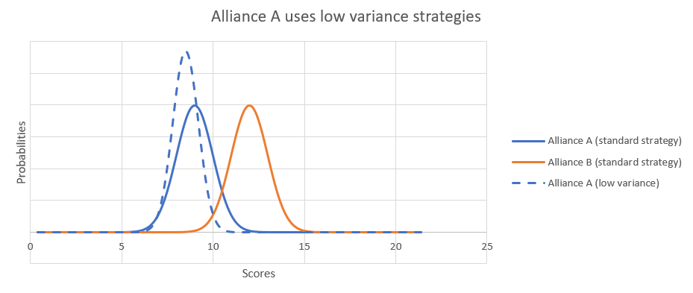
Variance adjustment
And conversely, how much less overlap there is when A goes for low variance strategies.

Slide 13
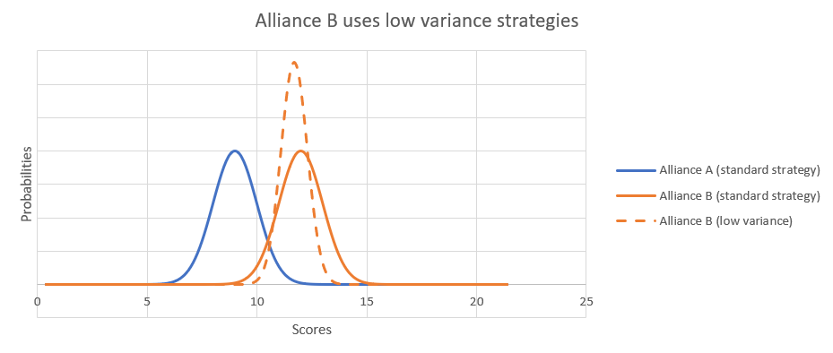
Variance adjustment
It is in the favorite’s best interest to opt for low variance strategies, note how much less overlap there is between A’s and B’s score probabilities when B goes for low-variance strategies

Slide 14
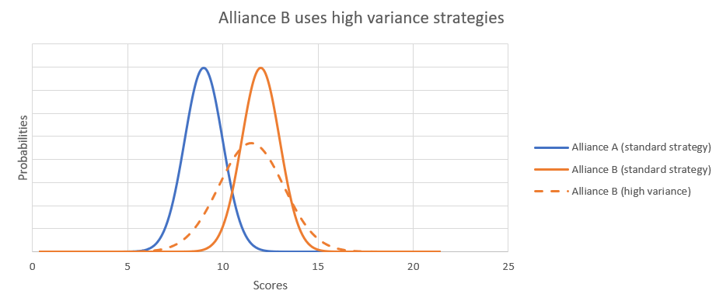
Variance adjustment
And conversely, how much more overlap there is when B goes for high variance strategies.

Slide 15
Match strategy “Variance adjustment” in pro sports
High Variance Strategies
Low Variance Strategies
NFL: Lots of passing, spiking the ball to stop the clock, blitzing, timeouts, onside kicks, hail marys
NBA: Shooting 3 pointers, shooting fast, intentional fouling, timeouts
NHL: Pulling the goalie, generally more aggressive play
NFL: Lots of running, letting the play clock go low, keeping safeties deep on the field, not using timeouts, squib kickoffs, this craziness
NBA: running down the shot clock, not using timeouts, trying harder not to foul
NHL: Lots of passing to control possession, try hard to avoid fouls.

Slide 16
Can you think of any ways to get high variance in frc matches? Low variance?

Slide 17
Match Strategy “Variance adjustment” in FRC (not exhaustive lists)
High Variance Strategies
Low Variance Strategies
Untested/minimally tested auto modes
Off-meta strategies (e.g. send your best scorer over to play defense)
Giving yourself 5 less seconds to line up for the endgame
Add on that untested mechanism and give it a whirl
Aggressive defense
Risk some fouls (e.g. hold the pins a bit longer, stay right on the edge of the protected zone when defending)
Switching up game plan in second playoff match
Very reliable, but slower auto modes
Sticking closely to the “meta”
Giving yourself 10 extra seconds to line up for the endgame
Tweak as little as possible about your robot before the match
Limited/no defense
Be hyper-aware of fouls
Repeatedly choose the same strategy in playoffs

Slide 18
When to adjust your variance
In the pro sports I mentioned, teams begin seriously adjusting the variance in the last few minutes of the game. Since FRC Matches are less than 3 minutes long, it would be wise for you to go into matches with an idea of how much variance you want.
Obviously, there should be a bit of on-the-fly variance adjustment by the coaches during the match. But considering how chaotic matches already are you should have some kind of guideline.
Enter win probabilities. Before entering the match, you should use whatever tools at your disposal to understand if you are the underdogs or the favorites in the upcoming matches, and by how much.
You should also know what your goals are for the match (Win, maximize RPs, get at least X RPs, etc…) and take that into consideration. Remember, in addition to winning/losing, you also have to consider RPs.

Slide 19
How to make win probabilities
Win probabilities are not the only thing you can use to determine if you want high or low variance, there exist other useful alternatives. For example, you could predict the scores of both teams and look at how big the expected winning margin is. Likewise, you could give each alliance some kind of overall “rating” and look at how big the gap is between you.
Since I like probabilities when coaching, I will generally first do one of the latter 2 options above, and then plug that “difference” into the following formula:
WP = 1/(1+10^(d/s)) where:
WP = Win Probability
d is the difference in skill or expected score between your alliances, to calculate this, sum all opponent ratings and subtract out all ratings of the teams on your alliance.
s is some kind of scale factor you must experimentally determine. It can be thought of as the difference in skill between the teams required for the stronger team to win 10 times more than the weaker team.
For Elo, s = 400
For my OPR calculations, I use 2.0*(standard deviation of week 1 scores), or about 34 in 2019
If you use scouting data to make a score prediction, I would generally recommend 1.6*(standard deviation of week 1 scores), or about 25 in 2019. Higher if you have less data or bad data, lower if you are feeling very confident in the predictions later in the event.

Slide 20
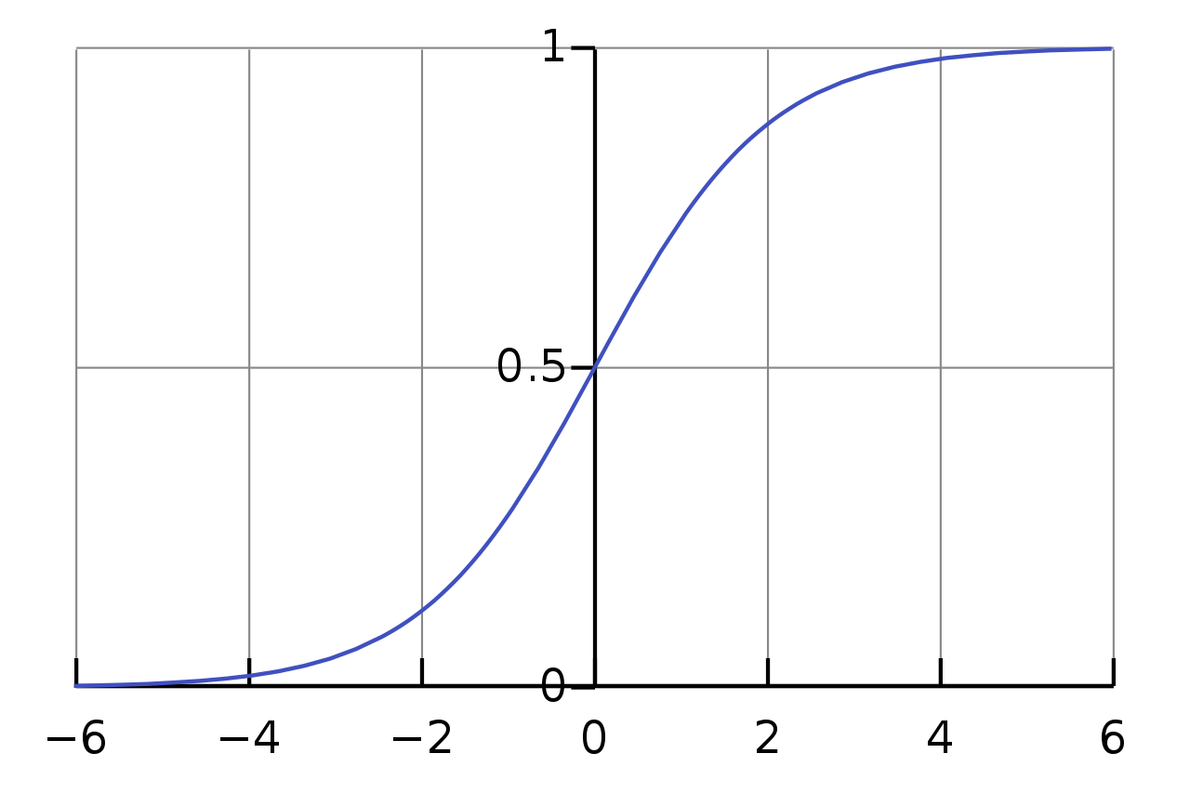
Logistic Function
The previous formula is called a logistic function, which essentially just turns a linear “skill” difference into a non-linear probability function as shown below (x-axis units are arbitrary).
As you can see, when the red alliance is much stronger, blue WP -> 0%, when alliances are even, blue WP = 50%, and when blue alliance is much stronger, blue WP -> 100%.
Blue alliance win probability
blue alliance “strength” – red alliance “strength”

Slide 21
General game plans
When I did drive coaching, I usually used Elo/OPR to make a match prediction, and later at the event I would take scouting data and adjust the prediction 20% or so based on what that told me. I would then pick a general game plan. Specifics varied a lot depending on the match and our teammates, but you should have an estimate of what will happen even before you begin planning with teammates.
Here are the game plans I roughly followed:
Strong favorites (WP > 70%)
Low variance strategies
Plan to focus more on bonus RPs (since W/L RPs are mostly decided)
Underdogs (WP < 30%)
High variance strategies
Plan to focus more on bonus RPs (Since W/L RPs are mostly decided)
Roughly even with opponents (30% < WP < 70%)
Just focus on average points maximization and don’t worry about variance
Plan to focus more on getting W/L RPs than bonus RPs because W/L is worth 2 RPs

Slide 22
Pause for questions

Slide 23
Scouting and Alliance selection
Whenever possible, if the FMS provides robot-specific scoring breakdowns, you should incorporate those into your scouting. Generally these are auto mobility and endgame points. You can copy those right out of my event simulator if you want or build your own interface to FIRST’s or TBA’s APIs.
By the time you get around to alliance selection, hopefully you have enough good scouting data to let that drive your alliance pick, however, you can still gain some insight from the non-scouting statistics.

Slide 24
Comparing CCs to scouting data for Additional insights
Comparing calculated contributions directly to your scouting data for related categories can frequently provide some interesting insights. I tend to estimate the kind of “uncertainty” around a specific calculated contribution value at about 10%, and values close to 0 can just be thought of as 0.
With the above in mind, don’t get too hung up on differences, but I like to take a look at the 5-6 teams that have the biggest differences between both systems. Such teams will often be over or under rated by your scouting data because the impact the team has on the field (positive or negative) is not fully captured by your scouting methodology. Examples:

Slide 25
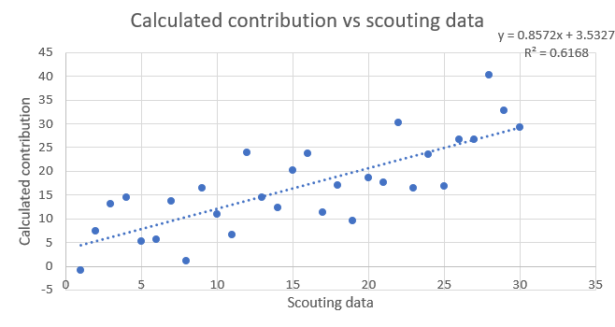
Visual inspection
Here’s a graph showing a hypothetical scouting data total points estimate versus calculated contribution to total points for the same teams. Note the strong but imperfect correlation between these two methods.

Slide 26
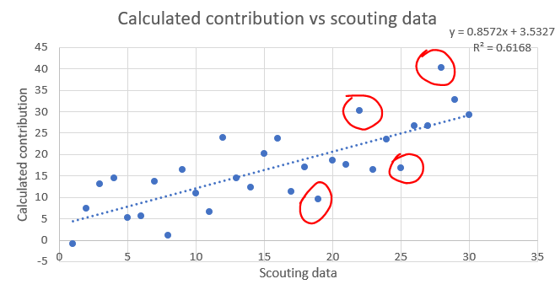
Visual inspection
If I were looking at this graph, these are the teams that would stand out to me. There is a good chance these teams are doing something that is captured in their calculated contributions that the scouting data is not seeing.

Slide 27
Comparing CCs to scouting data for Additional insights
Comparing calculated contributions directly to your scouting data for related categories can frequently provide some interesting insights. I tend to estimate the kind of “uncertainty” around a specific calculated contribution value at about 10%, and values close to 0 can just be thought of as 0.
With the above in mind, don’t get too hung up on differences, but I like to take a look at the 5-6 teams that have the biggest differences between both systems. Such teams will often be over or under rated by your scouting data because the impact the team has on the field (positive or negative) is not fully captured by your scouting methodology. Examples:
(2019) Calculated contribution to level 3 climb is much higher than team’s climb count according to scouting: Team is small enough to fit on the level 3 climb with another team.
(2018) Calculated contribution to auto mobility is much lower than team’s auto mobility rate according to scouting: Team is demanding to start in a specific location, blocking other teams from using their normal autos.
(2017) Calculated contribution to scored gears is less than the number of gears a team hands to pilots: Team is dropping gears at the loading station, blocking other teams from scoring their normal amount of gears.
(2016) Calculated contribution to teleop boulders scored is much higher than 0 even though team doesn’t score boulders: Team has an amazing HP that can bowl all the way to the other side and also in-game the team will block opposing HPs from doing likewise.
These differences can frequently represent what in sports they refer to as “intangibles”
In order to understand the meaning of the differences, it is crucial that you understand exactly what both metrics represent, and what attributes of the game one or both are blind toward.

Slide 28
Variance adjustment in alliance selection
Just like with matches, you should use variance adjustment when selecting your alliance. The amount of variance you should aim to achieve depends on which alliance number you are and what your competitive goals are (win the event, wildcard, district points, etc…)
For alliance number, I and others have event simulators you can use to get a feel for which rank you and others will likely be. Or just wait until quals are over.
For competitive goals, you need to determine that before the event. For example, here are some possible goals:
To got the most District Points on average
To get at least X District Points (At later events district events, you can usually get a good prediction for what X is to get you a slot at your District Championship)
Win the event
Obtain a wildcard

Slide 29
What are some characteristics of high variance or low variance selections?

Slide 30
Alliance selection “variance adjustment” (not exhaustive list)
High Variance
Low Variance
High peaks
One of the alliance members during the highest scoring qual match(es).
Half the team is scrambling around the pit working on the robot
Alliances coming up to you asking you to rewatch/rereview one specific match of theirs.
Something big and bad happens to robot in their last/second to last match
Some kind of specialty feature that could only demonstratably work during 1-2 matches, but worked well
Consistent performance
All/most matches have an above average score for the event
No one working on their robot during alliance selection
Alliances coming up to you saying “we never missed X” or “we only had one malfunction when doing Y all event”
Never is dead during a match
Can explain to you exactly why something went wrong the 1 or 2 times it did, and how it has since been fixed and tested.

Slide 31
Pause for questions

Slide 32
Elo vs OPR
Elo
OPR
Slightly more predictive power
Units can be difficult to interpret
Has a different value after each match, so at any point in time a team only has one “current” Elo rating
Ad hoc mess designed for predictive power (empirical basis)
Zero-sum in season
Slightly less predictive power (I take an average of Elo and OPR predictions in my simulator for best results)
Units of points, so much easier to interpret
Must be calculated on a set of matches (usually the entire season or one event), as such a team will have multiple OPRs depending on the set of matches
Strong mathematical foundation (theoretical basis)
Not zero-sum

Slide 33
How good of predictions can we make?
The alliance with the higher average Elo will win about 72% of the time, although it varies depending on the year
OPR predictions are correct about 1-2% less of the time than Elo

Slide 34
How good of predictions can we make?
Roughly, here are my estimates of how good you can get predictions in FRC, obviously these are year dependent, but I think these are in the ballpark:
Simple algorithms using only raw match scores (Elo/OPR) – 75%
Advanced algorithms using detailed score breakdowns (working on this one now) – 80%
Algorithms using scouting data – 80%
Human predictions from someone who watches a lot of matches – 80%
Predictions from someone who watches a lot of matches and also has detailed scouting data on hand – 85%
90% and higher - Not possible on a large number of matches

Slide 35
Other uses of statistics
Event simulation
Global rankings of teams
Determining “schedule strengths”
Predicting awards
Finding obscure contributors to match results (time between matches, alliance color, alliance station assignment, etc…)

Slide 36
Miscellaneous things I’ve learned
Across both robot performance metrics and Chairman’s strength metrics, I’ve found that teams revert toward the mean about 20% between each season. Meaning each team has a “half-life” of around 3 years. This shouldn’t be too surprising given how much churning there is of students, but still interesting that this arises from modeling.
If you have multiple data points for a team across different events, using the maximum value tends to provide better predictive power than the most recent value.
The predictive powers of Elo/OPR fluctuates a fair amount year to year. There exist lots of “improvements” to these metrics that help predictive power a lot in one year, but do nothing or even decrease predictive power in following years. Examples include:
Weighting the strongest team’s rating more heavily
Trying to incorporate bonus RPs
Adding non-linearities to the Elo-update formula (logarithms, bonuses for winning, geometric instead of arithmetic means)

Slide 37
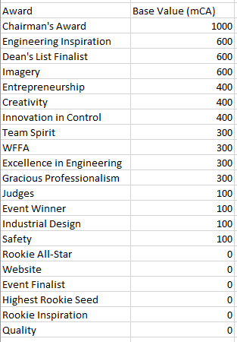
Miscellaneous things I’ve learned
For Chairman’s predictions, here is the relative value of each award for winning Chairman’s in the future:

Slide 38
Future Developments (theoretical and practical) that I’m planning to dive into eventually
Hybridizing Elo and OPR ratings into a single cohesive metric
A more advanced Elo that requires much more tuning at the start of each season, and to incorporate detailed score breakdowns
Diving into the Zebra DART data
More and better awards predictions
Alliance selection predictions

Slide 39
Rant about the name “OPR”
The name OPR is really awful, so I prefer to use “calculated contribution”.
Offensive – This word is obsolete
Power – This word is meaningless
Ranking – This word is just wrong, at least try to use “Rating” instead

Slide 40
That’s all folks (for this part of the presentation)
Feel free to reach out to me for any questions or comments on Chief Delphi (username Caleb_Sykes) or by email: calebsyk@gmail.com
All of my work can be found on my GitHub: https://github.com/inkling16/
Scouting Database
Event Simulator
Historical Elos
Miscellaneous Projects

Slide 41
How to calculate FRC metrics
All remaining slides dive into more detail on how to calculate frc metrics

Slide 42
Assumptions for calculated contributions
Choose to represent each team’s strength with a single continuous metric
The metric we choose is their arithmetic mean (average) contribution to the match score
We choose to combine individual contributions into an alliance combination linearly and equally weighted for all teams
Besides alliance composition, we are only allowed to look at one data point (score in the case of OPR) per half-match
All data must come from a finite set of quals matches within the current season
At least as many half-matches as teams in the dataset
Surrogates and DQed teams are treated no differently from other teams

Slide 43
Ways to calculate OPR
OPR at it’s root is just linear regression, which is a common statistical tool with many calculation methods. Here are 3, ordered from least computationally efficient to most:
Iterative Averages: Find each team’s “average” score, and make a score estimate based on that. Then for each team’s match, subtract out the partner’s strength and find a better “average” score that accounts for your partners
Linear Algebra (Matrix Inversion): Use tools of linear algebra to do the above iterative methods in a closed-form way
Linear Algebra (Choleskey decomposition): Since matrix inversion is computationally intensive, this is an even faster way to perform OPR calculations

Slide 44
OpR calculation method 1, iterative averages
The idea of this method is just to find each team’s average score, but then to incorporate information about partners to improve on this average. Repeating this step repeatedly will get us something very close to OPR
We’ll be working through your worksheets for this method, so I recommend pulling out a calculator app and getting together in groups of 2-5.
I have created the simplest non-trivial example I could on this worksheet, which includes only 5 teams, 4 full matches, and 2 teams per half-match. All concepts here will translate to other OPR calculations, with 3 teams per half match and far more matches and teams.

Slide 45
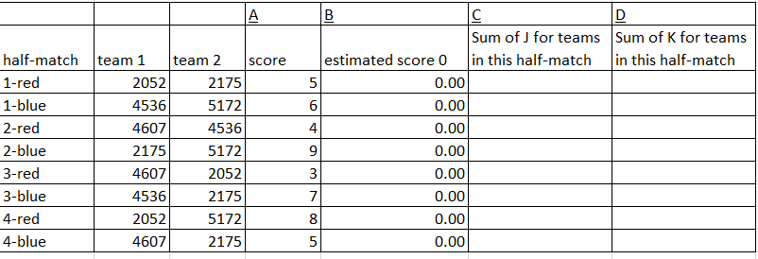
OpR calculation method 1, iterative averages
The very first step that we’re going to do is to come up with an initial guess for the scores. On your sheets, I have made the first guess 0, and in Col I, you’ll also see starting OPR estimates of 0.
Next, I want you to simply find the error of our estimate to the actual score, and divide this by 2 (because any error will be equally split between 2 teams). Place this result in Col E.

Slide 46
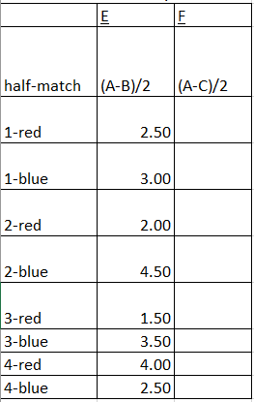
OpR calculation method 1, iterative averages
This value represents how good or bad our predictions are for each match. Obviously, we would like all of these values to be as close to 0 as possible.
Now, in Column G, I want you to take the average from column E for the matches each team participates in

Slide 47
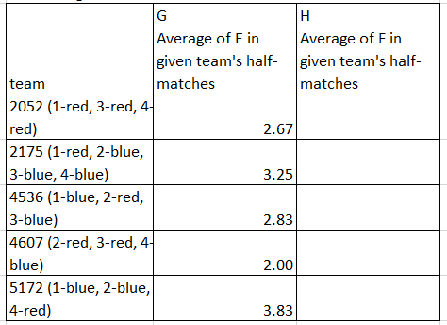
OpR calculation method 1, iterative averages
This value here is basically each team’s average score, it’s a little bit different, because we are only taking half of the final score, but it’s the same idea as a simple average
Now, take the results from G, and add them to I (I know, this is super easy right now, trust me, it’ll get harder ☺)

Slide 48
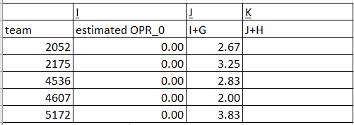
OpR calculation method 1, iterative averages
So now we have our first iteration of estimated OPRs! That wasn’t too bad right?
Don’t worry, things will get a bit harder the second time around
Now, I want you to take the results from J, and bring them up to the top to “estimate” the match score

Slide 49
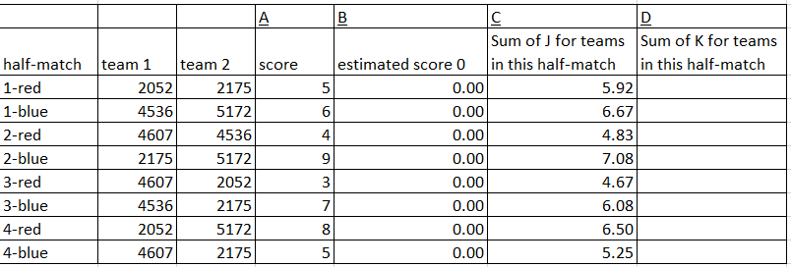
OpR calculation method 1, iterative averages
Not too bad, right? These estimated scores line up reasonably well (±2 points) with the actual scores.
Now just repeat all of the steps

Slide 50
Pause for questions

Slide 51
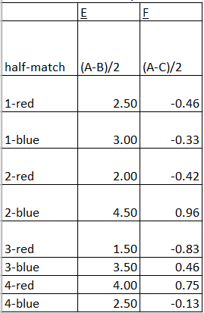
OpR calculation method 1, iterative averages
Notice how much smaller the “errors” are the second time around, that’s good, that means we are getting better estimates

Slide 52
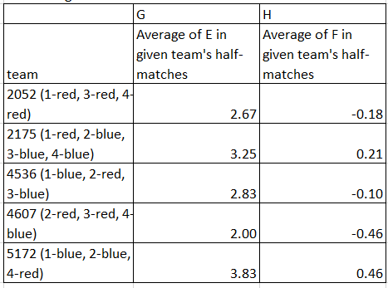
OpR calculation method 1, iterative averages
The OPR changes are also much smaller, turns out average scores was a better estimate of team performance than just saying everyone will score 0

Slide 53
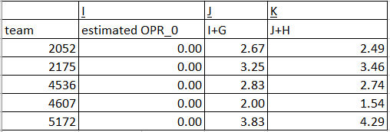
OpR calculation method 1, iterative averages
Here we are then, our estimated OPRs after two iterations
Let’s plug them into the estimated scores and see how we’re doing

Slide 54
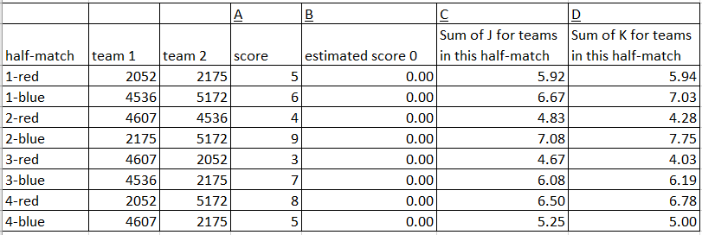
OpR calculation method 1, iterative averages
Not perfect by any means, but the error is now ±1.5 points for all scores

Slide 55
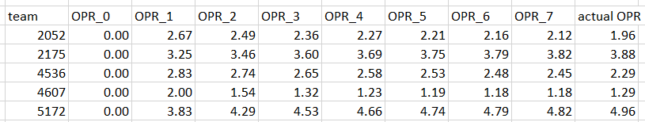
OPR Calculation Method 1, Convergence
If we continue this process forever, this iterative method will converge to normal OPR.
If your results differ from the completed worksheet. Review that to see where you got off track.

Slide 56
Pause for questions

Slide 57

OPR calculation method 2, linear algebra approach using matrix inversion
This method is generally how people calculate OPRs in software, all of my OPRs are calculated using the formula below.
The idea is to use tools of linear algebra to simplify the processes from methods 1 and 2.
For those of you who have learned linear algebra, the equation is below, where X is a schedule matrix, y is a score matrix, and beta is the calculated contribution. Read the wikipedia article on least squares regression to learn how it’s derived, or ask me after.

Slide 58
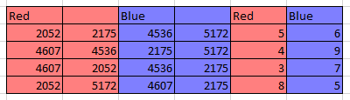
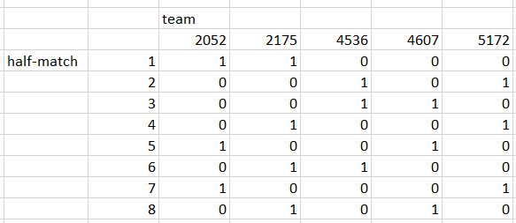
OPR Calculation method 2, Step 1
Here is the schedule, as well as the schedule matrix

Slide 59
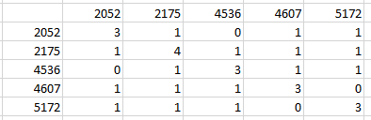

OPR Calculation method 2, Step 2
Find a matrix which shows how many matches each team plays with every other team

Slide 60
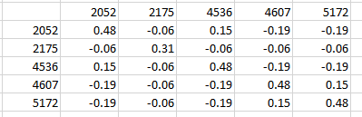

OPR Calculation method 2, Step 3
Invert that matrix, which gives a numerical value of how “important” each team is for every other team’s OPR

Slide 61
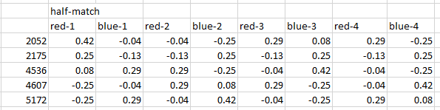

OPR Calculation method 2, Step 4
Multiply that matrix with a transposed schedule matrix to determine how “important” each half-match is for each team

Slide 62
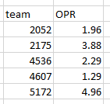

OPR Calculation method 2, Step 5
Multiply with whatever score matrix you are interested in, and then you’re done! You’ve found that calculated contribution

Slide 63
OPR calculation method 3, Choleskey decomposition
Go take a linear algebra course to understand this one. Here’s the wiki article.
This method is best for calculating OPRs using more than a single event worth of data, or if you are using a program with limited processing power. Using my computer and excel, here are rough timetables for OPR calculations:
I actually use matrix inversion for all of my work because I rarely calculate global OPRs and I’m lazy.
Method | Matrix Inversion | Choleskey decomposition
Single event | 1 second | <1 second
All events in 2018 | ~4 hours | 2 seconds

Slide 64
CCWM, DPR, and component OPRs
Once you know how to calculate normal OPR, calculating all of these other metrics are trivial, just swap in the “score” with whatever you want.
For CCWM, replace red’s score with (red score-blue score) and likewise for blue
For DPR, replace red’s score with blue’s score and likewise for blue (Note that DPR sucks)
For Component OPRs, replace red’s score with whatever component of red’s score you are interested in and likewise for blue
Due to our assumption of linearity, one interesting property is that any metrics that are linearly related will have corresponding linear OPR relationships. For example, since (for red) the winning margin is defined as (red score-blue score), we have that CCWM = OPR – DPR. Likewise, if you sum auto+teleop+penalty calculated contributions, you will get OPR.

Slide 65
Pause for questions

Slide 66
What is Elo
The Elo rating system is a method for calculating the relative skill levels of players in zero-sum games such as chess. It is named after its creator Arpad Elo, a Hungarian-American physics professor. -Wikipedia
If you have ever played any online games that have match-making algorithms, you have probably used some variant of the Elo rating system.
The basic idea is to give each team (and by extension each alliance) a rating, and then to predict the match outcome when looking at both alliance ratings. After the match, we compare our predicted results to the actual results. Teams/alliances which overperformed our expectation will see their ratings increase, while teams that underperformed will see their ratings decrease.
There are lots of different ways you can set up an Elo model, so from here on I’m going to be talking about how I set up mine.

Slide 67
Assumptions for My Elo
Maximize predictive power
Use as few parameters as possible, and only use parameters that improve predictive power in all recent (i.e. 2002+) FRC seasons (possibly excepting 2015)
Only use data that has been available since 2002, which is basically just alliance composition and final scores.
Minimal tuning required at the start of a new season
Team Elos can be taken as a raw sum together to get the alliance Elo
Average Elo = 1500, and an Elo difference of 400 indicates the stronger alliance is a 91% favorite. This lines up with most Elo systems, although these specific choices are arbitrary

Slide 68
Some key differences between Elo and OPR
OPR is a mathematical construct that happens to be well-suited for FRC purposes. As such, it has strong mathematical foundations and useful mathematical properties.
Elo is an ad hoc mess designed just to make the best predictions possible. There are mathematical underpinnings, but the key properties of an Elo model are experimentally derived parameters that give the model the properties we desire.
OPR is calculated all at once on a set of matches (usually just matches at a single event). That is, no outside information is required. Elo in contrast, always requires a “seed” Elo value, and cannot be calculated at an event without first using some“seed” rating going into the event.
Elo is zero-sum, which means that in season, the average Elo rating will always be the same. OPRs are only tied to scores, so if the average score goes up, the average Elo of teams at that event will also go up.

Slide 69
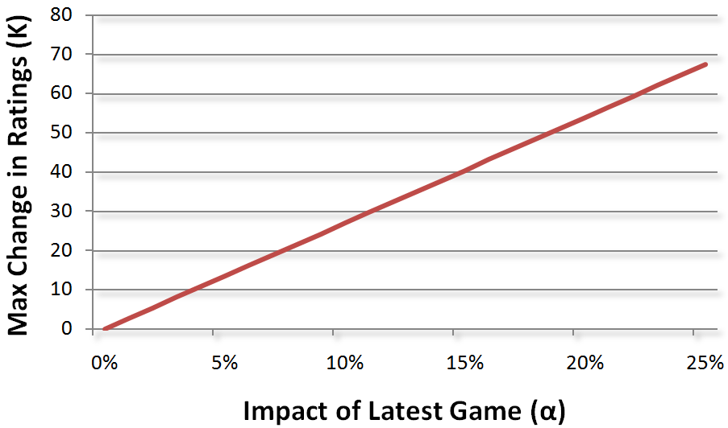
Key parameters (in season)
My model has 7 parameters which were experimentally derived, the following 2 are the only 2 used during the season:
kQuals = 12: A k value indicates how much a team’s rating should change based on the results of a single match. As you can see in the below chart, this means that roughly 5% of a team’s rating comes from their performance in the previous match
kPlayoffs = 3: The playoff k-Value is one quarter of the quals value. The reason for this is likely because, once teams enter static alliances in playoffs, it is difficult for the model to tell which team is actually responsible for successes/failures on the field, since all 3 alliance members will always have the same winning margins.
Elo to score ratio = 0.004: This parameter indicates what winning margin the Elo model should predict based on a difference in team Elos going into a match. This value means that, in a match where the red alliance is 250 Elo points above Blue, we would expect the final score to be 1 score standard deviation in red’s favor.

Slide 70
Key Parameters (between seasons)
Rookie/New Veteran Elo = 1450: Remember, average Elo is 1500, so 1450 corresponds to roughly a 30th percentile team
Previous season Elo weight = 70%: Each team’s Elo at the start of a 2019 will be 70% of their 2018 max Elo plus 30% of their 2017 max Elo (max Elos ignore each team’s first 8 matches)
End of season mean-reversion = 20%: This means that a team’s Elo at the start of a new season is dropped 20% toward the mean-reversion Elo. Essentially, teams go into a new season on average at about 80% of their strength the previous season.
Mean-reversion Elo = 1450: Because we are using max Elos, the end of season mean reversion must be below 1500 to keep the league average at around 1500.

Slide 71
Elo example
Using 2007 and score stdev = 32.9, this is a quals match
Red alliance has teams with Elos = 1450, 1500, and 1600. Blue alliance has teams with Elos =1500, 1650, and 1700.
Elo difference = 300 in favor of blue.
Predicted blue winning margin = 300*0.004*32.9= 39.5
Suppose the actual blue winning margin ends up being 52.6.
Each team on the blue alliance will have their Elo change by (52.6-39.5)/(32.9)*12 = 5. Since Elo is zero-sum in season, we also know that each red team’s Elo will change by -5.

Slide 72
Elo over multiple seasons
2052’s historical Elo

Slide 73
Elo over a single season
2052 in their rookie year
Note that 2007 score stdev = 32.9
Team | Year | Event | Match type | Set | Match | Elo | Predicted winning margin | Win probability | Win result | Winning margin
2052 | 2007 | Wisconsin Regional | qm | 1 | 8 | 1450 | -12.4 | 36.8% | 0 | -14
2052 | 2007 | Wisconsin Regional | qm | 1 | 12 | 1449 | 2.5 | 52.7% | 1 | 3
2052 | 2007 | Wisconsin Regional | qm | 1 | 22 | 1450 | 5.2 | 55.6% | 0 | -2
2052 | 2007 | Wisconsin Regional | qm | 1 | 28 | 1447 | -9.9 | 39.3% | 1 | 22
2052 | 2007 | Wisconsin Regional | qm | 1 | 39 | 1459 | -6.0 | 43.4% | 0 | -30
2052 | 2007 | Wisconsin Regional | qm | 1 | 45 | 1450 | 8.2 | 58.8% | 1 | 6
2052 | 2007 | Wisconsin Regional | qm | 1 | 58 | 1449 | -9.7 | 39.5% | 1 | 58
2052 | 2007 | Wisconsin Regional | qm | 1 | 65 | 1474 | 20.3 | 70.8% | 1 | 14
2052 | 2007 | Wisconsin Regional | qf | 4 | 1 | 1471 | 2.5 | 52.8% | 0.5 | 0
2052 | 2007 | Wisconsin Regional | qf | 4 | 2 | 1471 | 2.4 | 52.6% | 0 | -48
2052 | 2007 | Wisconsin Regional | qf | 4 | 3 | 1467 | -1.3 | 48.6% | 0 | -8
2052 | 2008 | Minnesota Regional | qm | 1 | 1 | 1462 | -8.3 | 38.0% | 1 | 12
2052 | 2008 | Minnesota Regional | qm | 1 | 10 | 1472 | -18.9 | 24.7% | 0 | -30

Slide 74
Pause for questions

Slide 75
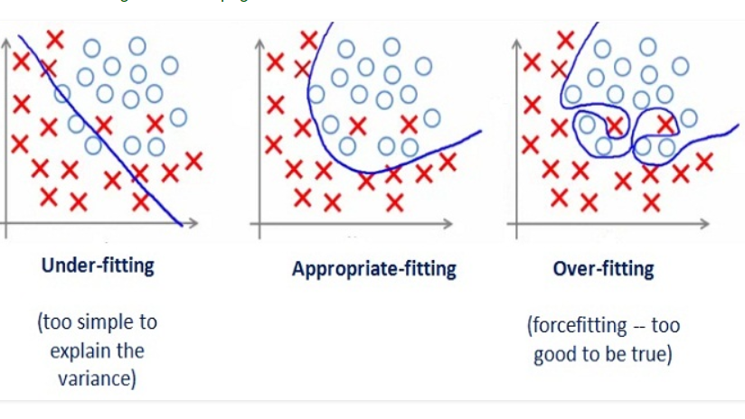
Overfitting vs Underfitting

Slide 76
Predicted Contributions (ixOPR)
When you don’t see OPRs displayed on TBA early at an event, that is because not enough matches have been played for there to be a singular solution for OPR.
When you see crazy high or low OPR values displayed early at an event, that is because the OPR model is drastically overfit, so it doesn’t represent anything meaningful
You need to have at least as many half-matches as teams for there to be a solution to OPR, and my personal rule is that OPR doesn’t become meaningful until there have been at least 1.5X as many half-matches as teams.
This really stinks though, ideally, we could adapt OPR somehow to give us reasonable values early at events. Enter ixOPR or “predicted contributions”

Slide 77
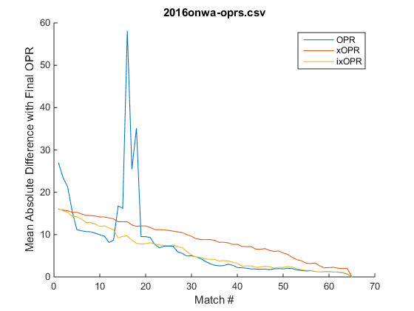
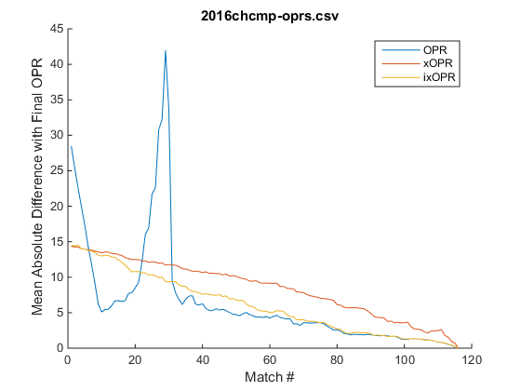
Predicted Contributions (ixOPR)
ixOPR was developed by Eugene Fang in 2016 to approach the aforementioned problems. His implementation involved estimating the scores of matches that hadn’t been played yet, and then running OPR calculations on those matches combined with matches that had actually been played.

Slide 78
Predicted Contributions (ixOPRs)
For best results, ixOPRs need to be “seeded” properly with some starting OPR for each team.
One option is to use 0 as a seed, which is safe, but we can usually do better.
For fastest convergence, I generally use:
each team’s max in-season OPR if the team has competed in the current season
90% of a team’s max previous-season OPR, and then adjusted for the current season by normalizing the average and stdev of OPRs between seasons
An OPR which is 0.4 standard deviations below the average for rookies that have not yet competed

Slide 79
That’s all folks
Feel free to reach out to me for any questions or comments on Chief Delphi (username Caleb_Sykes) or by email: calebsyk@gmail.com
All of my work can be found on my GitHub: https://github.com/inkling16/
Scouting Database
Event Simulator
Historical Elos
Miscellaneous Projects

